Slide 1
Restaurant Revenue Prediction Dataset
Charles Rice
DAB April 2026
Milton Mendieta
08/3/2026

Slide 2
Objective
Analyze the factors influencing a restaurant's revenue
Identify the strongest revenue predictors
Test the relationship between marketing and social media followers
Which attributes have the strongest relationship with annual restaurant revenue?

Slide 3
Overview
Source: Kaggle – Restaurant Revenue Prediction Dataset
Restaurant characteristics and annual revenue
Over 8,000 restaurants
Several key variables analyzed:
Average Meal Price
Seating Capacity
Marketing Budget
Number of Social Media Followers
Customer Rating
Cuisine Type
Location(Downtown, suburban, rural)
Chef Experience
Weekend and Weekday Reservations
Ambience Score
Service Quality Score
Annual Revenue(Target Variable)

Slide 4
Methodology
Microsoft Excel
Data Cleaning
Exploratory Data Analysis (Pivot Tables)
Tableau
Correlation Analysis
Dashboard Development

Slide 5
Hypothesis
Restaurants with larger social media followings generate more revenue than those with larger marketing budgets.
Result: ❌ Hypothesis Not Supported. Marketing budget had a stronger relationship with revenue than the number of social media followers.

Slide 6
Key Findings
Strongest Factors
Average meal price
Seating capacity
Marketing Budget
Weakest Factors
Customer ratings
Service-related measures

Slide 7
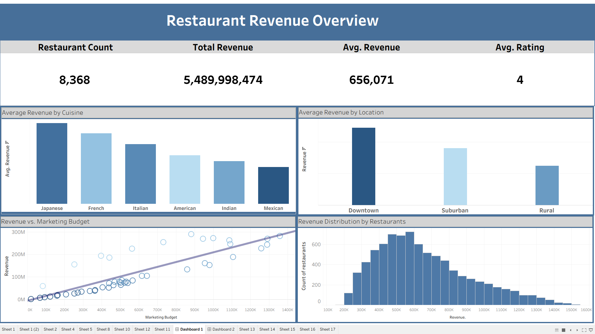

Slide 8
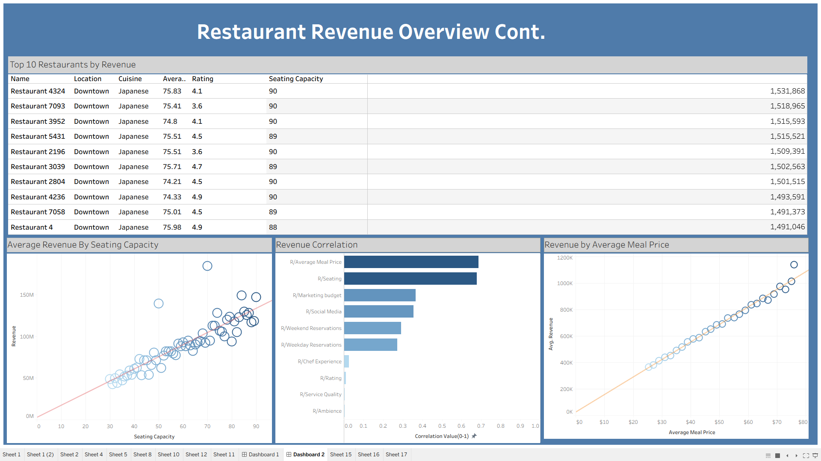

Slide 9
Recommendations
Meal Pricing
Optimize average meal price
Seating Capacity
Increase seating when demand supports it
Marketing
Invest beyond social media
Location & Cuisine
Consider downtown areas and Japanese cuisine

Slide 10
Conclusion
✔ Average meal price was the strongest predictor.
✔ Seating capacity significantly affected revenue.
✔ Marketing investment outperformed social media following.

Slide 11
Questions?

